Slide 1

TITANIC SURVIVAL
Tracy Chin
Matthew Thomas
Nabih Sabeh
Andi Rodriguez
Notes:
All aboard!

Slide 2








DATA TEAM
Notes:
Meet the crew.

Slide 3



TABLE OF CONTENTS
01.
02.
03.
04.
05.
DATA EXPLAINED
JOURNEY EXPLAINED
MODELS EXPLAINED
CLOSING
RESULTS EXPLAINED
Notes:
Gather 'round, dear passengers, as we unravel the mystery of our Titanic voyage through the lens of machine learning! Behold, the grand revelation: data, journey, models, and results during our evacuation.

Slide 4





01.
Problem Statement
DATA EXPLAINED
Notes:
We used the Titanic Dataset to explore what affected whether people lived or died. This dataset has a lot of information about the passengers that could help us identify the features that impacted their survival the most.

Slide 5
VALUE COUNTS
Total: 891
Male: 571
Female: 314
Survived: 342
Died: 549
Male: 109
Female: 233
Passenger Breakdown
Survival Breakdown
Survivors Breakdown
Notes:
To start our study, we found data on titanic passengers from Kaggle,
We wanted to do a thorough study. We started by doing a value count. To understand the passengers background
Here's what we found:
Out of 891 people, 571 were male and 314 were female.
594 passengers died while 342 survived - 233 survivors being female and 109 male.

Slide 6




COLUMNS DROPPED
Survived | PClass | Sex | Age | SibSp | Parch | Fare | Embarked | Passenger ID | Name | Ticket | Cabin
Live | Class | Gender | Age | Sibling or Spouse | Parent or Child | $ | Boarded At | ID# | Name | Ticket# | Cabin#
Notes:
While cleaning the data, we wanted to make sure we pick the right features for our machine learning model.
we used VIF to see if a feature in a model is related to other features, better known as multi-col-linear- ity in the model’s features.
We dropped Passenger ID, Ticket number and Name because its all unique to each person and will not have any impact on survival and will not help the predictions.
We also dropped cabin . even though the location of where the passengers stayed could affect their survivals based on where the ship started sinking from, this information is kind of included in P-class or passengers class.
We also dropped Fare to avoid inter-variable correlation and model overfitting.

Slide 7
DATA PROCESSING
1.
2.
3.
4.
Dropping Columns
Age Missing Values
Embarked & Gender Missing Values
Feature Engineering
Passenger ID, Ticket #, Name, Cabin, Fare
177 Missing Values
Missing handful of values
MAR, One Hot Encoder, and Label Encoder
Notes:
We also encountered missing values, let me walk you through how we dealt with it.
Age: significant challenge as its missing 177 values . We filled in missing ages using Multiple Imputation, or MICE for short, with a tool called Random Forest Regressor that guesses based on other information we have, making our data more complete and reliable.
Then for Gender, because its binary variable, we used One Hot Encoding to transform it into binary values?
And for the 'Embarked' column. We chose Label Encoding to convert this categorized data into numerical form

Slide 8
KEY VALUES
Parent/Child
Sibling/Spouse
Embarked
Class
Parch.
SibSp
C, Q, S
First, Second, Third
Gender
AGES GROUPED
0-18
19-30
31-50
35.2%
64.8%
51 & OLDER
Notes:
Here we have the remaining features which we will use
Parch = stands for Parents and Children each passenger had on board.
Sib SP = Siblings and spouses accompanying a passenger.
Those are family related variables could influence the survival rate
Embarked : Where passengers embarked from (3 locations)
Class: First, second and 3rd.
Gender (Male & Female)
Age split into 4 categories 0-18, 19-30, 31-50, 51 - older

Slide 9
02.
JOURNEY EXPLAINED

Slide 10




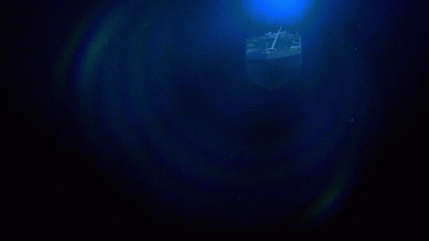

Southampton
Queenstown
Cherbourg
X
Notes:
The Titanic left England, heading to New York. It picked up most of its passengers in Southampton made 2 stops before it headed to New York where the ship hit an iceberg and sank in the middle of the north Atlantic Ocean

Slide 11
03.
MODELS EXPLAINED

Slide 12
MODEL PREPARATION
1. Spearman & Pearson Correlation Matrix
2. Female/ PClass
3. Random Forest Model Confirms
VALIDATED
Random Forest
xgboost
svm
Logistic regression
Decision trees

Slide 13
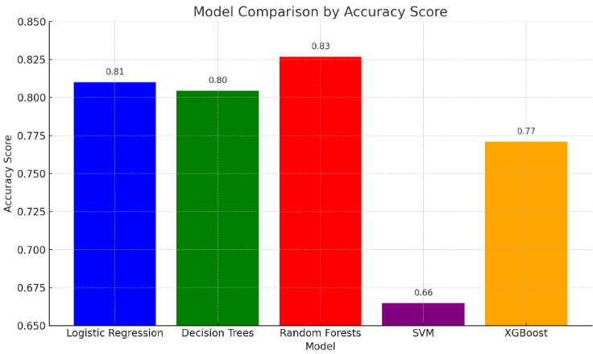
MODELS & HYPERPARAMETERS
GridSearchCV
5 Models
Random Forest is the Victor

Slide 14

MODEL EVALUATION
MODEL | ROC AUC SCORE
RANDOM FOREST | 0.8347
XG BOOST | 0.7855
LOGISTIC REGRESSION | 0.7799
DECISION TREES | 0.7724
SVM | 0.6066
ROC AUC Explained
AUC = 0.5, random
AUC closer to 1, more accurate
AUC closer to 0, less accurate
Notes:
Evaluation Results:
Logistic Regression: Achieved an accuracy of 79.33%, with precision at 77.61% and recall at 70.27%.
Decision Tree: Showed comparable performance with an accuracy of 79.33%, precision of 76.06%, and recall of 72.97%.
Random Forest: Demonstrated the highest accuracy at 82.68%, with precision and recall at 82.09% and 74.32%, respectively.
SVM: Yielded lower accuracy at 66.48%, with a precision of 76.92% and a notably low recall of 27.03%.
XGBoost: Achieved an accuracy of 80.45%, with precision, recall, and F1-score at 81.97%, 67.57%, and 73.48%, respectively.
Real-life Implications:
Logistic Regression and Decision Tree models offer a balanced trade-off between precision and recall, suitable for scenarios where both false positives and false negatives are equally concerning.
Random Forest emerges as the top performer in terms of overall accuracy, making it a reliable choice for applications prioritizing correct predictions.
SVM, while having a high precision, exhibits a challenge in identifying true positives, suggesting potential issues in correctly classifying survival outcomes.
XGBoost provides a robust balance between precision and recall, making it suitable for scenarios where achieving a balance between correctly identifying survivors and minimizing false predictions is crucial.

Slide 15
04.
RESULTS EXPLAINED

Slide 16
THREE CONCLUSIONS
GENDER
CLASS
AGE
Women had highest chance of survival.
Class was the second highest indicator for survival amongst males and females.
Missing values in “Age” row impaired this conclusion despite modeling. Correlation found between survival age group.
Notes:
The random forest classifier model predicted the following three features with the highest probability of surviving:
Gender- women had the highest chance of surviving
1st class - being in 1st class gave a person the 2nd highest chance of surviving
Age- after we replaced the missing values in the age column with the substituted values this feature had the 3rd highest chance

Slide 17

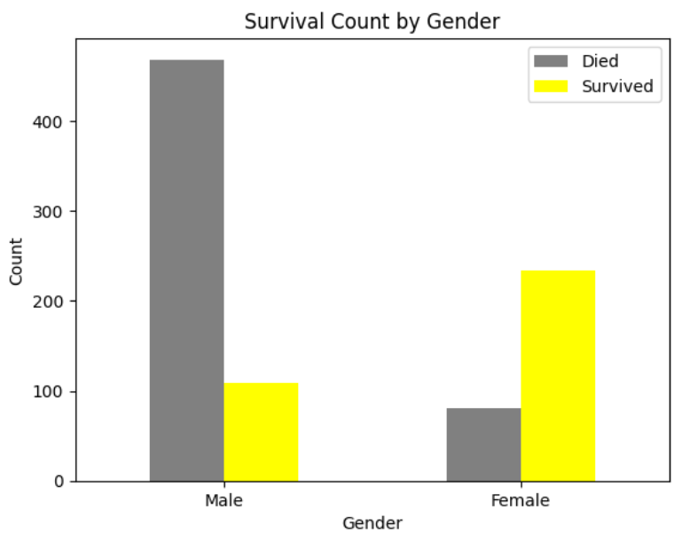
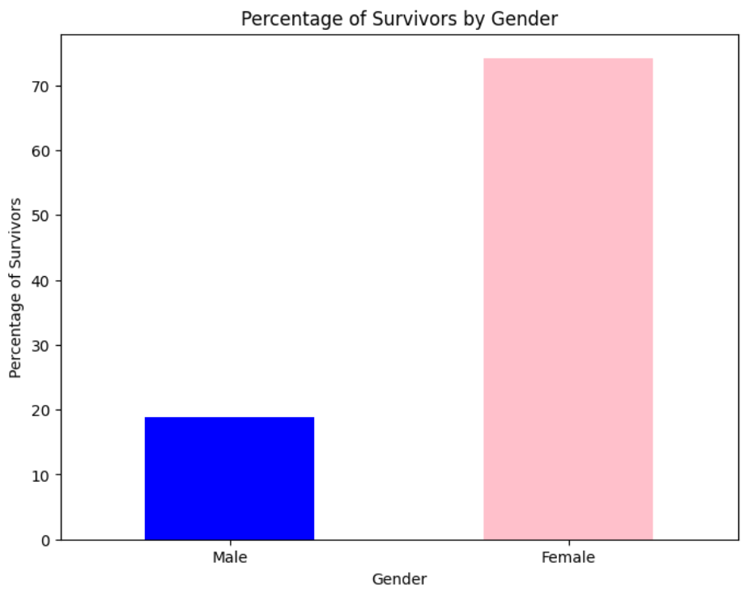

SURVIVAL BY GENDER
Notes:
These bar graphs give us a visual account of survivability by gender
As you can see the number of men on the ship is a lot higher than the number of women on the ship.
Interestingly enough, women outlived men by about 2:1.
There could be a number of factors that explain this but it is well known at that time in history it was
“Women and Children first”

Slide 18
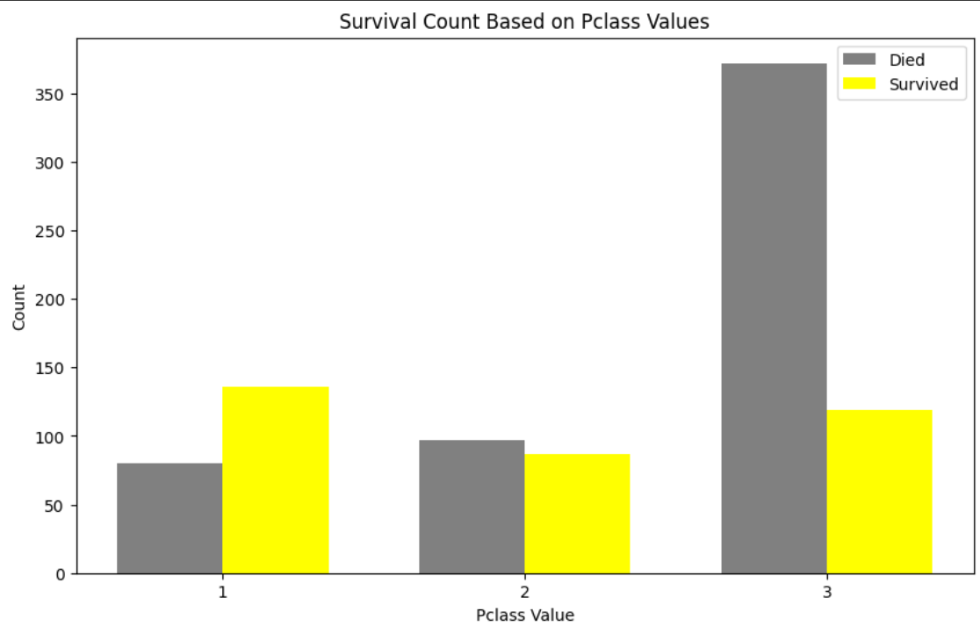
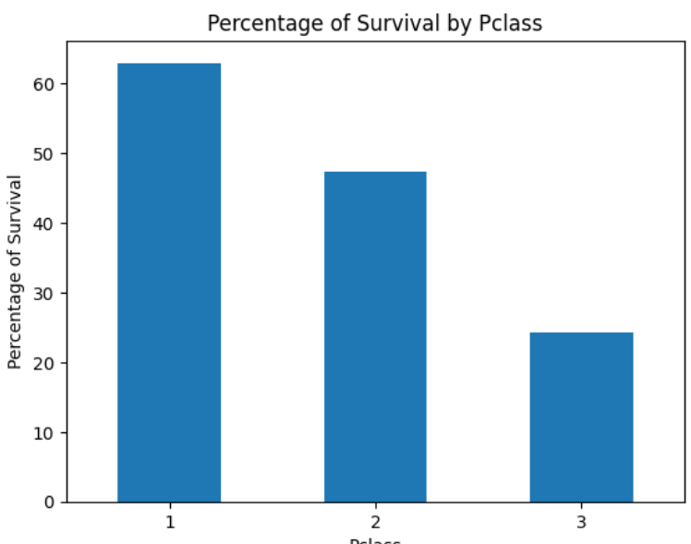
SURVIVAL BY CLASS
Notes:
As we review the statistics for survival by class we see that 1st class had the highest amount of survival in both absolute and percentage terms.
It should be noted that although the third class cabins had the highest number of passengers, its percentage of survivors was the lowest.

Slide 19
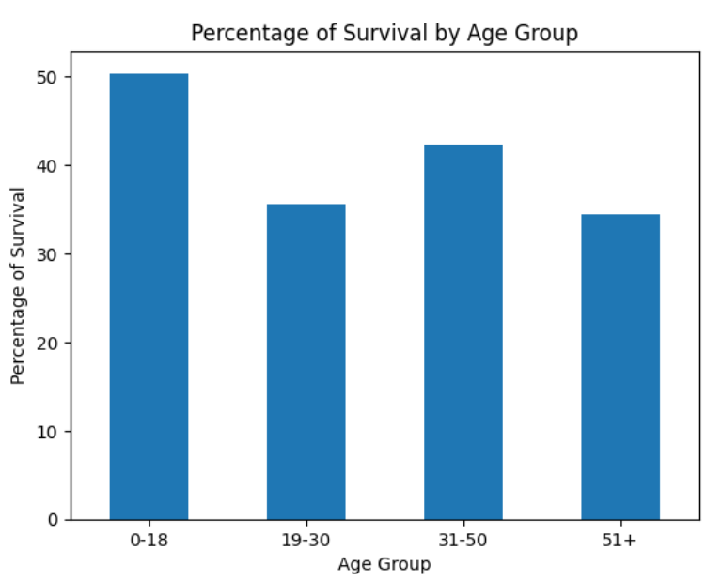
SURVIVAL BY AGE GROUP
Notes:
If our imputed values accurately represent the age of the passengers then our model suggest the 0-18 year old age group had the third highest survivability rate.
And now I will turn it back to andi to wrap things up.

Slide 20
05.
CLOSING
Notes:
There's been a collision. Everyone, stay calm and follow instructions. We must evacuate the ship immediately.
We need to get to the lifeboats. Follow me!"

Slide 21
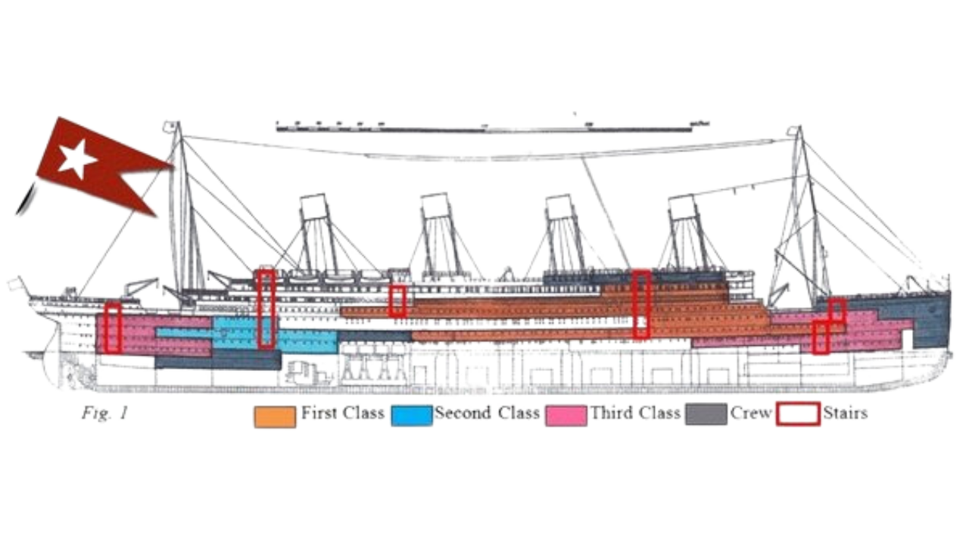
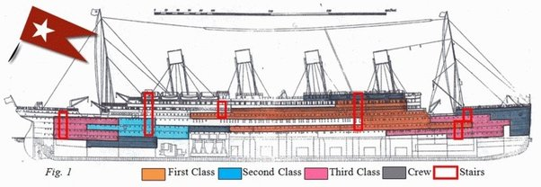
Survival Rate by Class/Location
67%
25%
47%
Notes:
First-class passengers had higher survival chances due to their proximity to lifeboats and priority during evacuation, compared to second and third class. Room location also mattered; those closer to lifeboats or on upper decks were more likely to survive than those farther away or on lower decks.

Slide 22

DID YOU KNOW?
The cost of a ticket for the Titanic varied depending on the class of accommodation. A first-class ticket could cost as much as $4,350 (equivalent to over $100,000 today), while a third-class ticket could be purchased for around $35 (equivalent to roughly $1,000 today).
The sinking of the Titanic prompted significant changes to maritime safety regulations, including the implementation of stricter rules regarding the number and capacity of lifeboats, improved wireless communication requirements, and the establishment of an international ice patrol in the North Atlantic.
COST OF TICKET
LEGACY

Slide 23
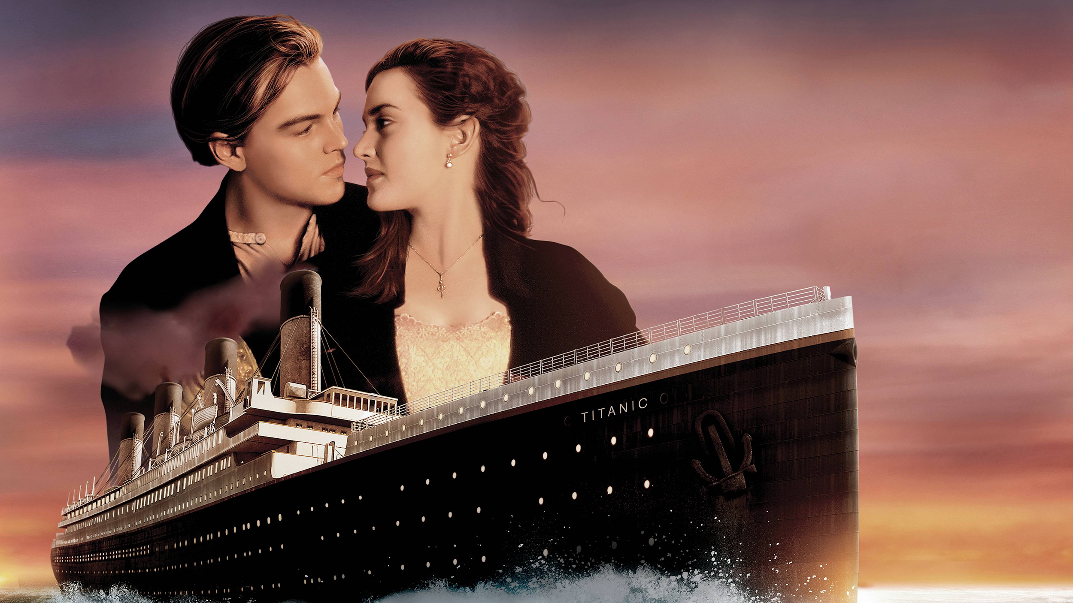
I’LL NEVER LET GO, JACK. I’LL NEVER LET GO.
Notes:
The film "Titanic" shows the consequences of negligence, as the ship's sinking was a result of preventable human errors. The belief that the ship was unsinkable, lead to inadequate safety measures and a lack of preparation for a potential disaster. Despite being designed to accommodate up to 64 lifeboats, the Titanic carried only 20 lifeboats and four additional collapsible boats. This was insufficient for the number of passengers and crew on board.

Slide 24

Thank You
Q&A
Notes:
Well, you see, folks, this fancy machine learning stuff has confirmed what we all knew about the "women and children first" rule during our Titanic evacuation. It's like a nod to history, showing how society's ways can really shape who makes it out alive. But it isn’t just about that. This analysis dives deep, shining a light on how bigger social issues play into who sinks or swims. So what's the takeaway? We gotta use these insights to plan better for emergencies, make smarter predictions, and most importantly, remember the human side of all this data stuff. Let's steer towards a future where everyone's got a fair chance, shall we?

